Slide 1
Key Certification Updates | 2016-2017

Slide 2
WHY THE UPDATE?
1. COMPLY WITH NEW NATIONAL STANDARDS
Teaching and Professional Knowledge
2. VALIDATE CANDIDATE’S UNDERSTANDING
Snowboarding Fundamentals and Categories
Teaching Fundamentals and Categories
Professional Knowledge Fundamentals and Categories
3. CANDIDATES ARE BETTER PREPARED FOR NEXT LEVEL OF CERTIFICATION
4. ONLINE REGISTRATION/ONLINE WRITTEN TEST
Notes:
Cert. Committee #2 Trainers observations on Hill What they can observe on a daily bases #3 Levels of understanding

Slide 3
POLICY & PROCEDURE UPDATES
Notes:
Cert. guide updates

Slide 4
policy and procedures:
20 hours of combined practical teaching hours and clinic, training hours.
10 hours minimum each for teaching and clinic time
On snow combined riding and teaching assessments
Up to 15 minutes for candidate to present teaching topic
6 hours on snow assessment, 1 hour indoor assessment
Group size of 6 people, 8 maximum
Required Synopsis – reviewed and signed by candidate and their trainer
Online Membership Join
Online Written Test
Online Registration for on snow test
Notes:
All disciplines accountable Log book suggested

Slide 5
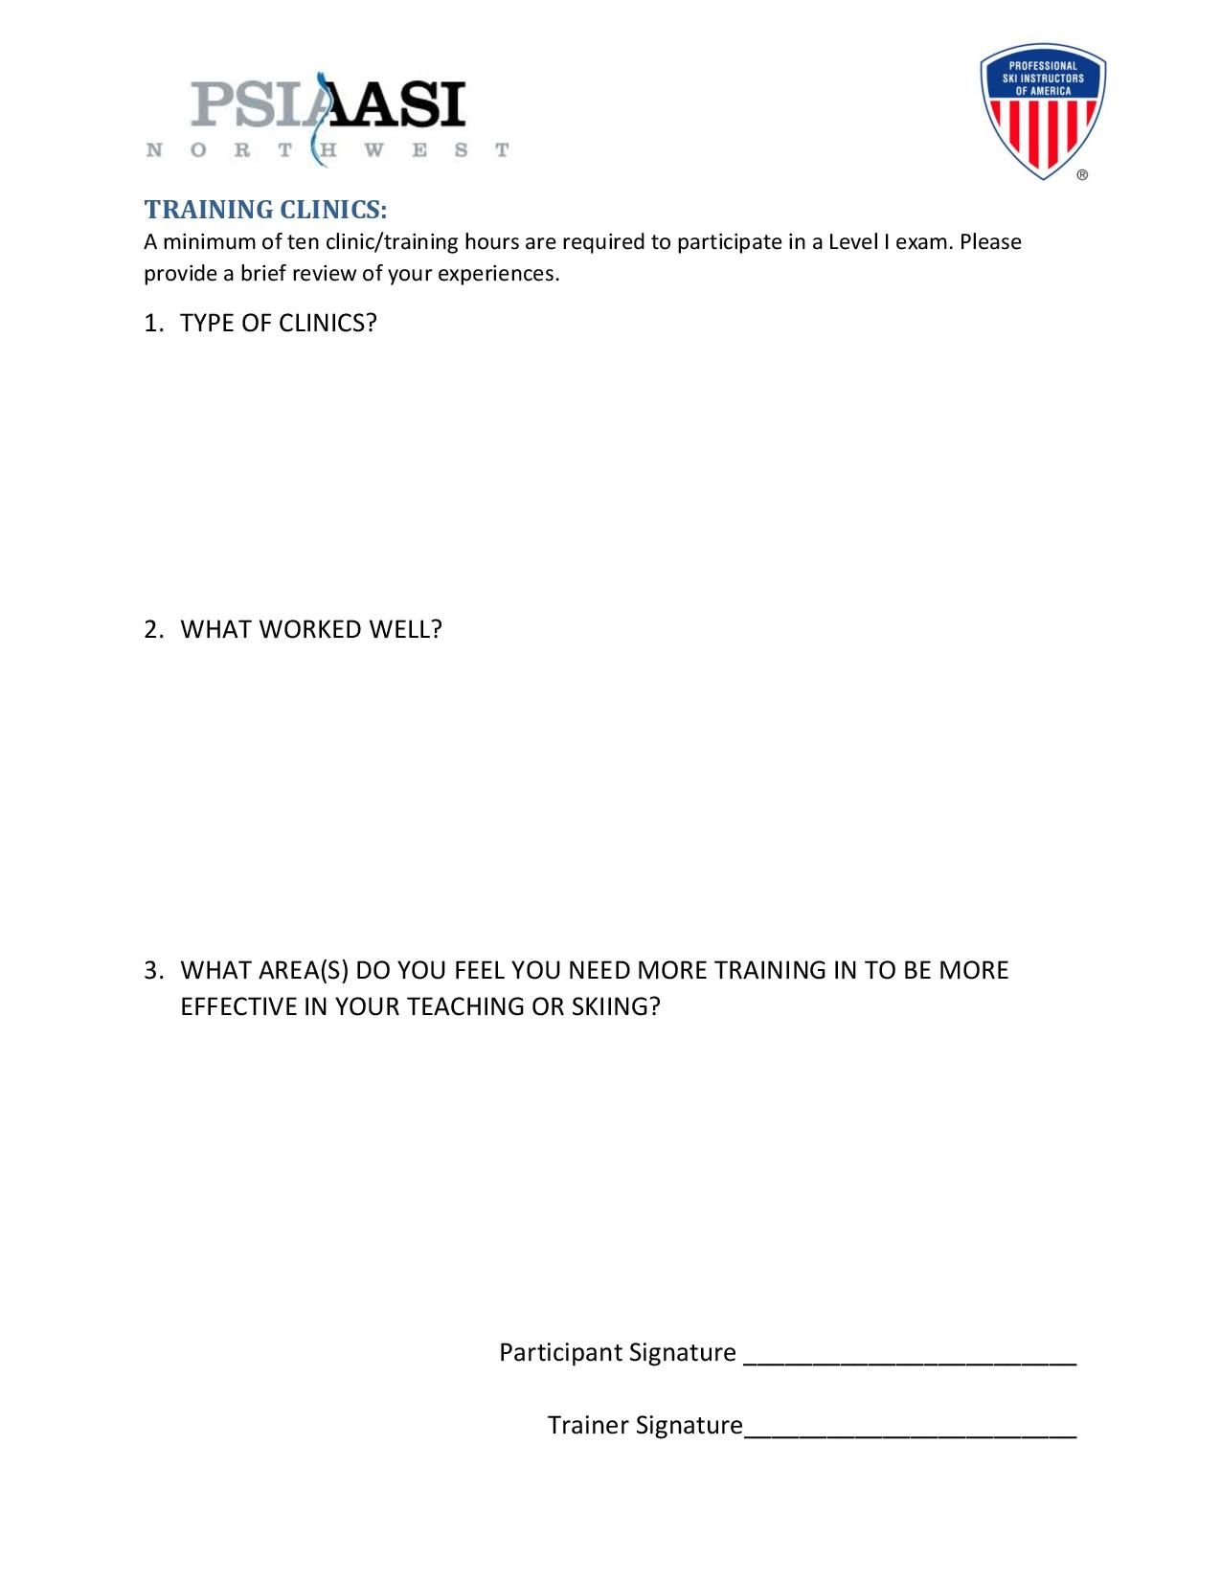

Slide 6
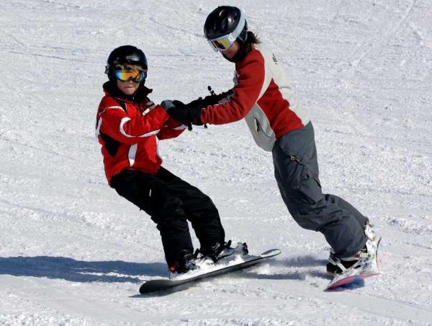
PRACTICAL TEACHING
1. What worked well?
Positive attitude
Keeping it Fun
Less talking, more activities
Clear visuals
Gaining Trust
2. What were your challenges?
Patience
Weather
Movement analysis
Parents
Group Handling, i.e. large group sizes, keeping on task, staying together, different skill levels within the group
Notes:
Cert. Committee #2 Trainers observations on Hill What they can observe on a daily bases #3 Levels of understanding

Slide 7
TRAINING CLINICS
1. What worked well?
The more clinics the better
Bringing riding back to the basics
Instructors who were approachable for guidance, questions and leadership
Rider improvement
2. What area(s) do you feel you need more training in to be more effective in your teaching or snowboarding?
Personal riding, all conditions, all terrain, better demos
Movement Analysis
Clear communication, Verbiage / Concise
Class handling, how to deal with splits, Bag-O-Tricks
Higher class levels
Notes:
Cert. Committee #2 Trainers observations on Hill What they can observe on a daily bases #3 Levels of understanding

Slide 8
SNOWBOARDING UPDATES AND REQUIREMENTS

Slide 9
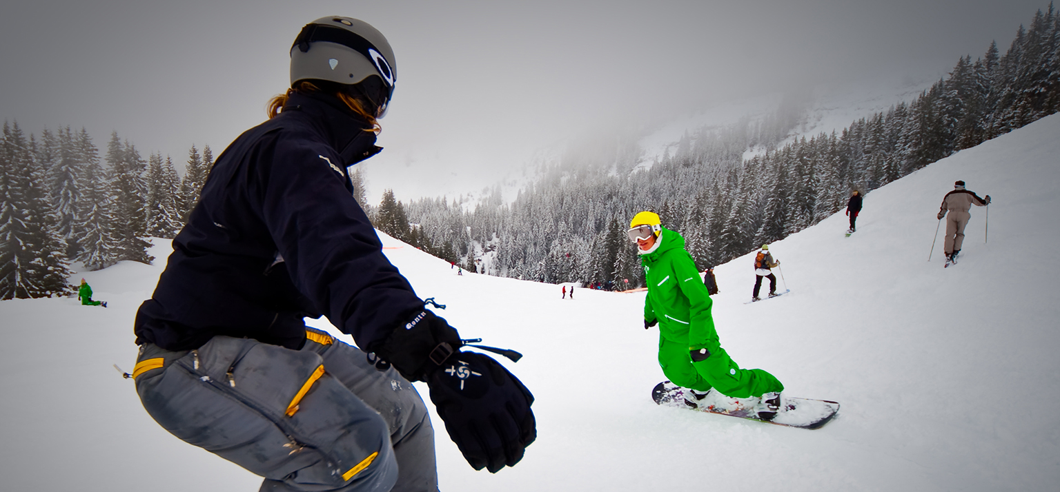
SNOWBOARDING REQUIREMENTS
SOLID FUNDAMENTALS THROUGH BLUE TERRAIN:
Skating
Fade Turns
Falling Leaf
Garlands
Basic Skidded Turn
Basic Switch Skidded Turn

Slide 10
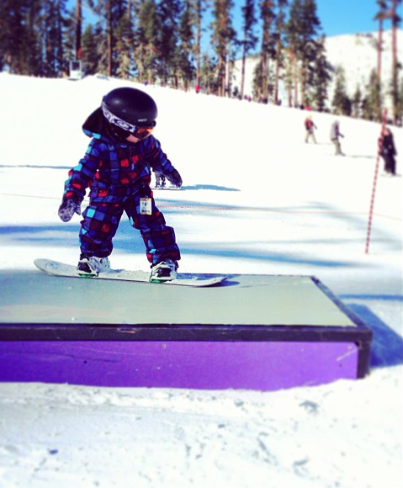
SNOWBOARDING REQUIREMENTS
SOLID FUNDAMENTALS THROUGH BLUE TERRAIN:
Dynamic Skidded
Basic Carved Turns
Ollie Airs
Flat Spin 3’s
Straight Air Over a Feature
Transitional Freestyle Element

Slide 11
SNOWBOARDING ASSESSMENT
Teaching presentation demonstrations
Participant demonstrations
Examiner set-up’s for beginner zone activities
Notes:
Teach up to beginner zone Ski up to intermediate zone

Slide 12
TEACHING & SNOWBOARDING ON-SNOW ASSESSMENT

Slide 13
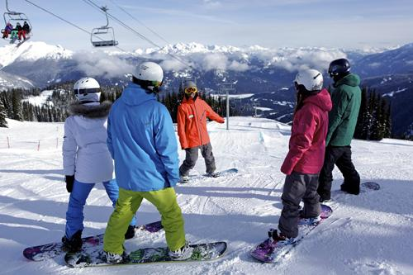
TEACHING CATEGORIES: 1. Safety 2. Communication 3. Movement Analysis 4. Demonstration 5. Teaching application 6. teaching styles

Slide 14
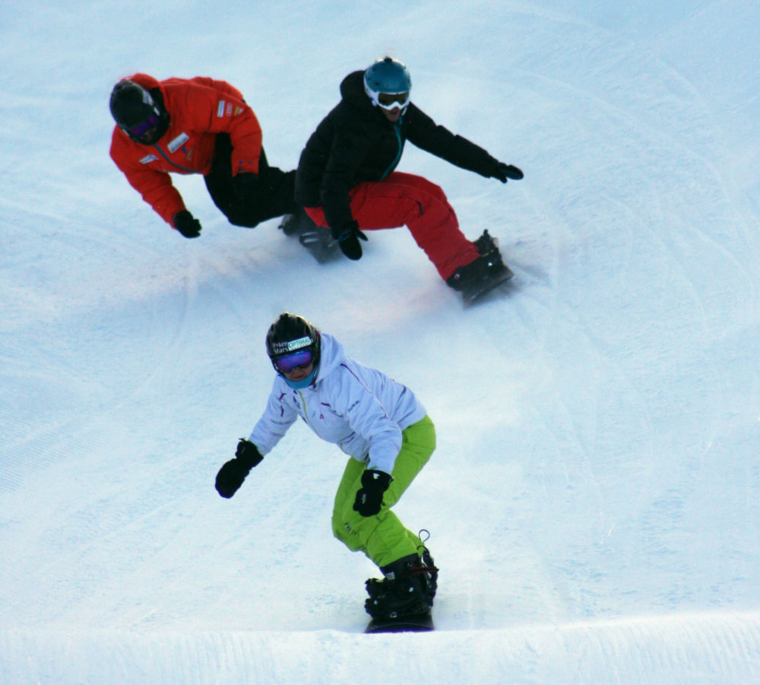
Professional Knowledge Categories: 1. terminology 2. teaching concepts 3. riding concepts 4. equipment 5. physics of SNOWBOARDING 6. biomechanics 7. turn mechanics 8. industry knowledge
Notes:
How to cover? Teaching presentation, Chair rides, indoor, written, group discussions

Slide 15
TEACHING and SNOWBOARDING ON-SNOW ASSESSMENT
what:
Receive assigned LEVEL 1 Solid Fundamentals Through Blue Terrain activity
Select ONE Snowboarding Fundamental as a main focus

Slide 16
Fundamental Mechanics – Body
CoM to Bos / Side to Side / Manage Magnitude of Pressure
Control Rotation
Inclination / Angulation
Fundamentals (Mechanics) Relate to Skills
Pressure
Control
Rotational
Control
Edge
Control

Slide 17
TEACHING and snowboarding ON SNOW ASSESSMENT
WhY:
Discuss Common Goal Outcome
Board Performance specific – Skills
Body Movements specific – Fundamentals

Slide 18
TEACHING and snowboarding ON SNOW ASSESSMENT
how:
Identify the different phases of a turn and HOW the skills are applied in each phase of the turn
Demonstrate riding task relative to the desired action of the snowboard
Observe peers and describe chosen snowboarding fundamental
Feedback is related to the snowboarding fundamental focus and HOW to achieve the desired action of the snowboard

Slide 19
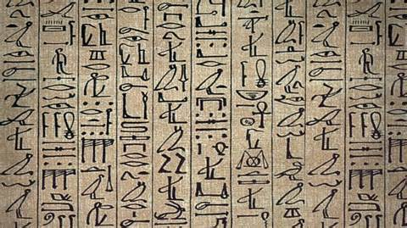
level 1 assessment WRITE UPS

